Slide 1
Superstore Sales Analysis Report Intern Name: Shah Pranjal PankajKumar Company : Brainwave Matrix Solutions Project Title: Superstore Sales Dashboard Toolset: Power BI | DAX | Excel Date: May 10, 2025
Introduction :
This report presents a comprehensive Power BI dashboard designed to analyze Superstore sales data across different categories, regions, and customer segments. The main goal of this project was to derive actionable insights and visualize performance metrics in an interactive, user-friendly way. The analysis includes insights on Sales trends, Best selling products, Total profit , supplier performance and key business metrics derived using excel , Dax Query and Power BI.
Key Metrics Visualized :
Total Quantity Sold: 5,239 units
Total Sales: $341K
Overall Profit: $27K

Slide 2

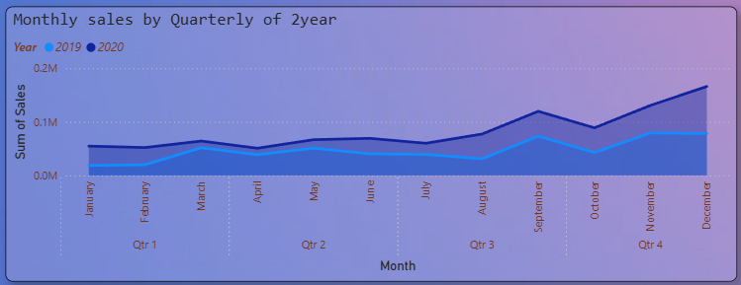
Average Delivery Days:
This report presents a comprehensive Power BI dashboard designed to analyze Superstore sales data across different categories, regions, and customer segments. The main goal of this project was to derive actionable insights and visualize performance metrics in an interactive, user-friendly way.
3. Monthly Sales Overview :
Monthly sales were analyzed over the years 2019 and 2020. A clear upward trend was observed, especially in Q4 of 2020, with December showing the highest sales spike at $166,185.85.
* Visualization: Line chart showing YoY monthly sales comparison (2019 vs 2020).

Slide 3
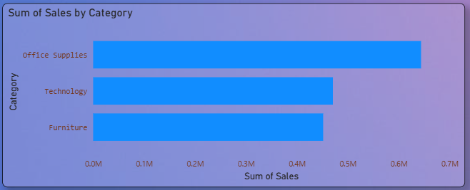
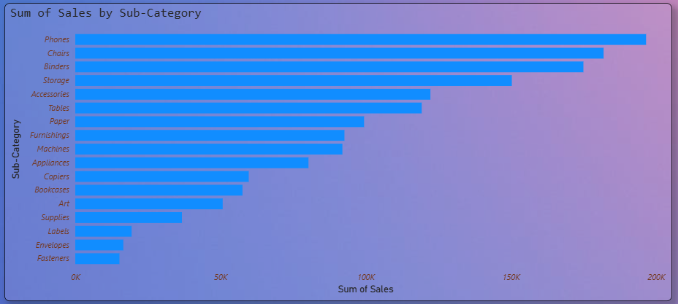
4. Top Performing Categories & Sub-Categories: By Category [Total Sales]:
(TOP 3 ) · Office Supplies: $643,707.69
· Technology: $4,70,587.99
· Furniture: $4,51,508.65
By [Sub - Categories] :
(TOP 3 ) · Phones: $196,563.55
· chairs: $181,946.00
· Binders: $174,978.39

Slide 4

5. Regional Sales Performance :
The West region led in sales contribution with $522,441.05, followed by the East and Central regions. Provide actionable insights to improve profitability.
* Sales by Region:
West: $171K B) East: $169K C) Central: $133K D) South : $81K
* Visualization Insight: Slicer

Slide 5
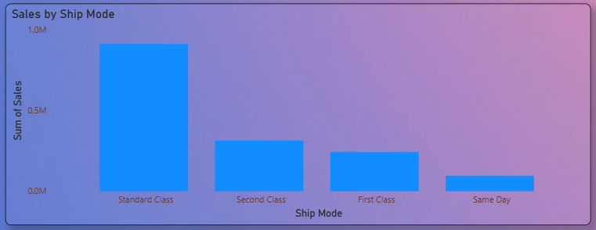
6. Shipping Mode Analysis :
Among all shipment options, Standard Class was most preferred with over $912K in sales. This suggests it is the go-to mode for cost-effective delivery. Ship Mode Breakdown:
Standard Class: $303K
Second Class: $112K
First Class: $82K
Same Day: $30K
Visualization: stacked bar showing sales by shipmode.

Slide 6
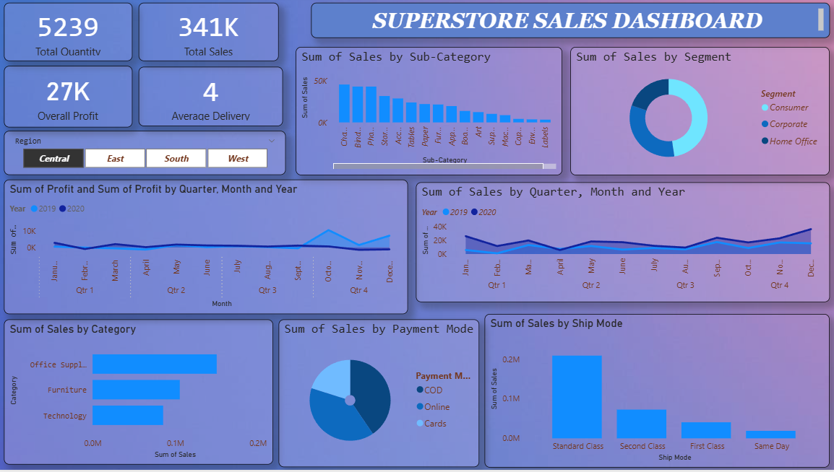
7. Power BI Dashboard & KPIs :
An interactive Power BI dashboard was created to present key performance indicators (KPIs) and data visualizations that enable quick insights and deeper exploration. The dashboard includes filters by region, category, sub-category, and ship mode.
* Key KPIs Displayed:
- Total Sales: $1,565,804.32
- Total Orders: 7,298
- Total Profit: $175,262.11
- Average Ship Time (Days): 4
- Top Region by Sales: West ($522,441.05)
Top Category by Sales: Office Supplies
($643,707.69)
- Top Sub-Category: Phones ($196,563.55)

Slide 7
8. Dashboard Visualizations:
Sales by Category: Horizontal bar chart showing sales across Furniture, Office Supplies, and Technology.
Sales by Sub-Category: Bar chart highlighting top-performing items like Phones, Chairs, and Binders.
Monthly Sales Trend (YoY): Line chart comparing monthly sales for 2019 and 2020 to identify seasonal patterns.
Sales by Ship Mode: Bar chart showing distribution across Standard Class, Second Class, First Class, and Same Day.
Sales by Region: Map visualization and summary table to show regional performance.
Sales by Segment: Donut chart showing Customer Segments (Consumer, Corporate, Home Office).
Payment Mode Breakdown: Donut chart representing share of payment methods (Cards, Online, COD).
9. Interactivity Features:
Year selection (2019, 2020)
Region filter (Central, East, South, West)
Category/Sub-Category
Ship Mode & Payment Mode
10. Insights & Recommendations
Prioritize inventory for Office Supplies and Phones, which lead in sales.
Optimize Standard Class logistics, as it’s the most used shipping mode.
Monitor Furniture category profitability, as it has the lowest profit margin despite high sales.
11. Tools Used:
Power BI: Interactive dashboard creation
Excel: Data pre-processing and pivot summaries

